Slide 1
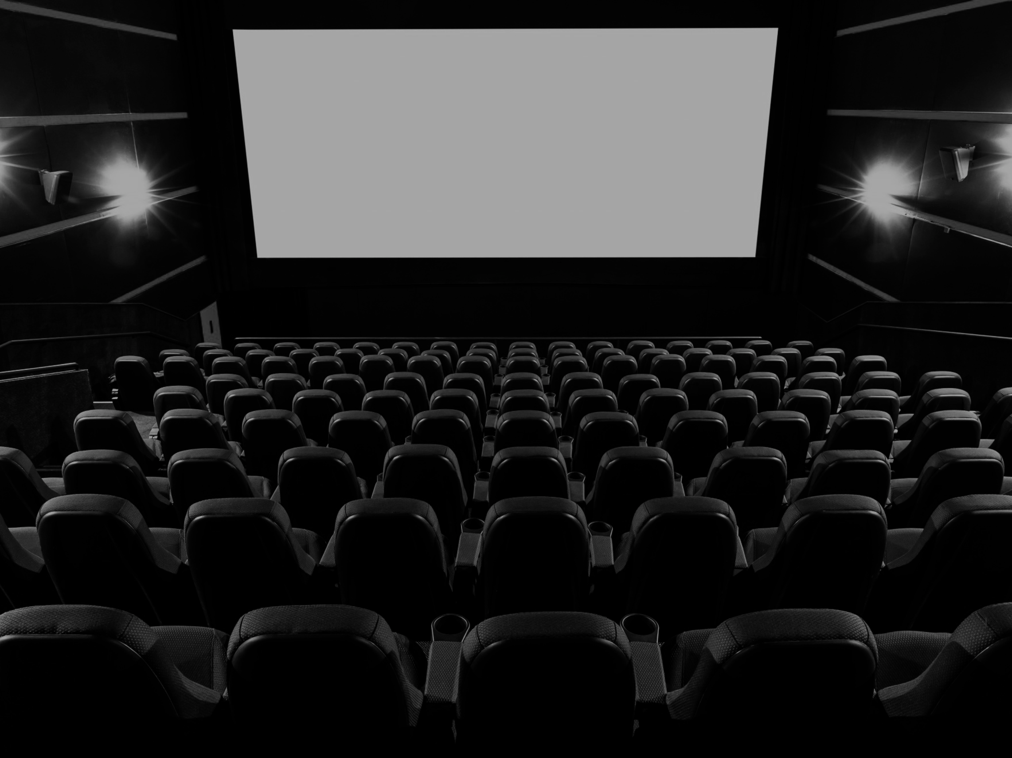
Analyzing Data from MovieLens
Team 8
Brendan Foley
Yuhui Gong
Luis Jimenez
Mu Niu
Matt Weiss

Slide 2

Basic Details of Collected Data
Number of movies with an average rating over 4.5 overall?
21
 | Men | Women
Average | 23 | 51
Median of people over 30 years old | 86 | 149

Slide 3


$$×sdf$$
Basic Details of Collected Data
Top 10 Popular Movies
Movie | Score
Shawshank Redemption, The (1994) | 0.8413
Schindler's List (1993) | 0.8284
Casablanca (1942) | 0.8270
Usual Suspects, The (1995) | 0.8153
Sixth Sense, The (1999) | 0.8130
Godfather, The (1972) | 0.8109
Raiders of the Lost Ark (1981) | 0.8074
Silence of the Lambs, The (1991) | 0.8058
One Flew Over the Cuckoo's Nest (1975) | 0.8054
American Beauty (1999) | 0.8011
$$Score=\left[\left(1−ratio\right) × 20\%\right]+\left[\frac{average rating}{max. possible raiting}× 80\% \right]$$
$$ratio=\frac{\left| number of male voters −number of female voters \right|}{all voters}$$

Slide 4
Basic Details of Collected Data
ID | Occupation | Avg_rating | STD
9 | homemaker | 3.4868 | 0.872799445
13 | retired | 3.4611 | 0.862035816
3 | clerical/admin | 3.4020 | 0.934390928
12 | programmer | 3.3918 | 0.935026507
15 | scientist | 3.3816 | 0.868145401
10 | K-12 student | 3.3637 | 1.026850526
18 | tradesman/craftsman | 3.3617 | 0.825533427
5 | customer service | 3.3574 | 0.903787785
8 | farmer | 3.3545 | 0.790726203
16 | self-employed | 3.3522 | 0.901704354
14 | sales/marketing | 3.3449 | 0.910138053
6 | doctor/health care | 3.3257 | 0.943222899
17 | technician/engineer | 3.3222 | 0.903137705
0 | other or not specified | 3.2916 | 0.972678469
7 | executive/managerial | 3.2638 | 0.947056375
2 | artist | 3.2563 | 0.976880262
11 | lawyer | 3.2332 | 0.949640709
1 | academic/educator | 3.2153 | 0.931278135
4 | college/grad student | 3.1897 | 1.008007799
20 | writer | 3.1468 | 0.9658032
19 | unemployed | 3.1431 | 0.981836592
Age | Avg_rating | STD
1 | 3.34 | 1.0261
18 | 3.16 | 1.0209
25 | 3.23 | 1.0032
35 | 3.28 | 0.9496
45 | 3.29 | 0.9207
50 | 3.34 | 0.9053
56 | 3.37 | 0.9089
Gender | Avg_rating | STD
F | 3.29 | 1.0045
M | 3.21 | 1.0054

Slide 5
Basic Details of Collected Data
Female raters tend be more homogeneous when rating movies.
People under 18 are the easiest group to please; people from 18 to 24 are the hardest group, however they tend to be less problematic when aging.
Homemakers and retired people are the easiest group to please, writers and unemployed people are hardest to please.

Slide 6
Histograms

Slide 7
Histograms
Results
Majority of extreme ratings were for movies receiving less than 100 ratings.
Only movies receiving ratings above a minimum threshold should be considered trustworthy.
More extreme ratings are 5 than 1.
Perhaps these are obscure movies with a small fan base that is very loyal.

Slide 8
Correlation: Men vs Women
Men versus women and their mean rating for every movie.
Men versus women and their mean rating for movies rated more than 200 times.

Slide 9
Correlation: Men vs Women
Correlation Coefficient
The correlation coefficient between men and women is 0.763 with a p value of 0.
This means that the correlation is very significant.
Shows that the ratings are similar.
For young viewers the correlation is 0.56, while for old viewers it is 0.75.
Movie tastes among genders are more similar for older people than younger people.

Slide 10

Correlation: Men vs Women
Correlation Coefficient
The correlation coefficient for young people is higher than that of old people at a significance of $p=2.6 × {10}^{−43}$, which is very significant.
Drama correlation is 0.58, while for comedies is 0.68.
Movie tastes among genders are more similar for comedies.

Slide 11

Correlation: Men vs Women
Correlation Coefficient
The correlation coefficient for active movies is higher than that of non-active with $p=4.5 × {10}^{−14}$.
The correlations don’t seem to change based on location $p=0.78$.

Slide 12
Correlation: Men vs Women
Conjectures
Factors that influence homogeneity:
age
how mainstream a film is
genre
Factors that don’t influence homogeneity:
Location
male-popularity

Slide 13
Business Intelligence
Which story should the studio invest into a movie?
Is there any story that would be worth making a sequel or prequel in order to extend the movie franchise?

Slide 14
Business Intelligence
Conjectures
Nine out of the ten movies are within the genre of drama.
Drama is the preferred genre among male and female raters in the database.
Average rating for each is greater than 4 stars.
All ten movies have more than 1500 raters.

Slide 15
Business Intelligence
Conjectures
Story should be targeted to women, in their middle ages.
This basing on how female rankers and housemakers are the easiest groups to please.
The story would have to be a drama, related preferably to a criminal story.
Appealing to men as well.

Slide 16
Business Intelligence
Idea to Pitch
Warner Brothers making a prequel movie of The Shawshank Redemption.
Showing Ellis Boyd 'Red' Redding's life (Morgan Freeman's character) before meeting Andy Dufresne (played by Tim Robbins).
The expansion of the movie franchise would add to the $58.5 million that the box-office made in 1994 when released.

